Slide 1
Friend Finder Android App
Project Members
Sanket.S.Kulkarni
Rakesh.S
Yashaswini.N
H.S. Nagbushan
Final Year
Jyothy Institute Of Technology
Guide-
Harish.K Sir

Slide 2
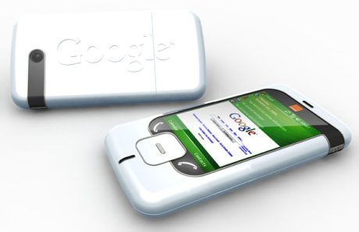
Location-Based Services
Location-Based Services or LBS allow software to obtain the phone's current location. This includes location obtained from the Global Positioning System (GPS) satellite constellation, but it's not limited to that.
The API is considered as "optional“ API as an application can still be build without using the Location-Based API.
For example, an Android application cannot be writtien without using the Activity and Intent APIs, but an application may not need to know where the user is, so the need of the Location-Based Services API maybe not be use. In this sense, the LBS API is optional where the Activity API is not.

Slide 3
Scenarios
Location based services can be used in so many different scenarios. Such examples include :
Ride Sharing
Meet Anywhere
Social networking/Mobile Social networking
Buddy Finder/ Friend finder
location based Advertisement
location based business locator
tourism guides with text popup in different locations
Navigation
Traffic management
Car Parking guide
Mobile games
Emergency Services

Slide 4
Geographic Limitation. Most of the current geographic search engines are only limited to USA and Canada. Some of them have a wider coverage including UK, Australia, Japan, Taiwan and few more countries. Other search engines which have not been mentioned here are (also often limited to a city or country or even to a specific language.
Data Limitation. Existing location-based engines only cover commercially collected information of local businesses e.g. those mentioned in Yellow Pages. They do not cover World Wide Web although they might have link to those pages.

Slide 5
API'S
The Location-Based API includes two packages android.location & com.google.android.maps that provide an initial look at the support in the Android platform for building location-based services.
Location-Based Service
android.location
com.google.android.map

Slide 6
LocationManager provides an API to determine location and bearing if the underlying device supports it. This class provides access to the system location services which allow applications to obtain periodic updates of the device's geographical location, or to fire an application-specified Intent when the device enters the proximity of a given geographical location.
The LocationManager should not be instantiated directly, but rather a handle to it should be retrieved.
The application will be able to do three things:
Query for the list of all LocationProviders known to the LocationManager for its last known location.
Register/unregister for periodic updates of current location from a LocationProvider (specified either by Criteria or name).
Register/unregister for a given Intent to be fired if the device comes within a given proximity (specified by radius in meters) of a given lat/long.

Slide 7
Location Class
A class representing a geographic location sensed at a particular time (a "fix"). A location consists of a latitude and longitude, a UTC timestamp. and optionally information on altitude, speed, and bearing.
Information specific to a particular provider or class of providers may be communicated to the application using getExtras, which returns a Bundle of key/value pairs. Each provider will only provide those entries for which information is available. Some common keys are:
"satellites" - returns the number of satellites used to obtain the fix

Slide 8
Location Based On Class
LocationProvider Class
An abstract superclass for location providers. A location provider provides periodic reports on the geographical location of the device. Each provider has a set of criteria under which it may be used; for example, some providers require GPS hardware and visibility to a number of satellites; others require the use of the cellular radio, or access to a specific carrier's network, or to the internet. They may also have different battery consumption characteristics or monetary costs to the user. The Criteria class allows providers to be selected based on user-specified criteria.
LocationProviderImpl Class
An abstract superclass for location provider implementations. Location provider implementations are typically instantiated by the location manager service in the system process, and location information is made available to implementations via the manager.

Slide 9
Address Class
A class representing an Address, i.e, a set of Strings describing a location.
Criteria Class
A class indicating the application criteria for selecting a location provider. Providers maybe ordered according to accuracy, power usage, ability to report altitude, speed, and bearing, and monetary cost.
Geocoder Class
A class for handling geocoding and reverse geocoding. Geocoding is the process of transforming a street address or other description of a location into a (latitude, longitude) coordinate. Reverse geocoding is the process of transforming a (latitude, longitude) coordinate into a (partial) address.

Slide 10
Android architecture
The Android platform runs on a Linux kernel and contains several libraries and
application frameworks. To start developing Android applications the Android
SDK (Software Development Kit) is needed. The Android SDK provides necessary
tools and API:s (Application Programming Interface) for developing your
own applications with the Java programming language. See Figure 2 for the full
platform architecture.[3]
An API is a documentation or a specification in form of source-code intended
as an interface in software development. When using an API all software components
within the API can communicate with each other. An API may include
several specifications in how to use the components, e.g. data structures, routines,
object classes, methods and variables

Slide 11
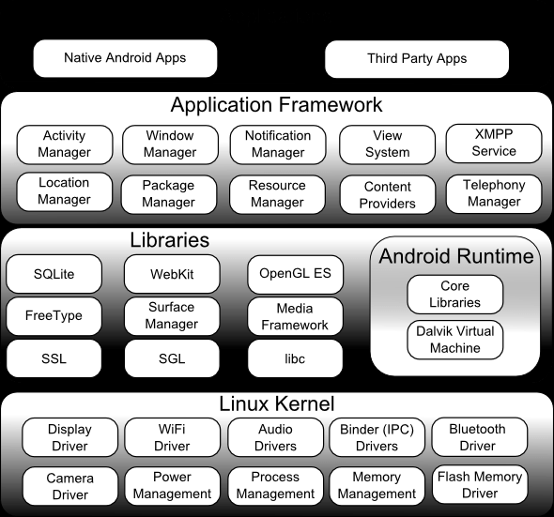

Slide 12
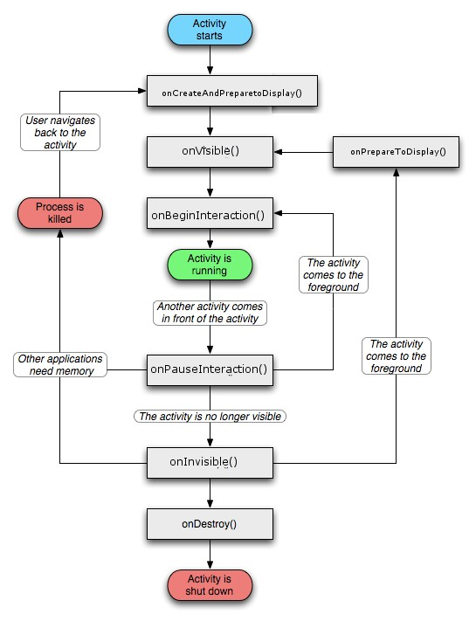
Activity Diagram

Slide 13
XML Layout
Android offers a convenient way of setting the layout of an application. The UI
can be setup in the code and/or by declaring the UI elements in XML. This is11
a smart way of separating the layout design from the code that handles the user
interactions. The developer may also use different XML layouts depending on
different circumstances, e.g. different screen sizes or platform version. Listing shows an example of .xml code.

Slide 14
Listing 1: .xml code example
<?xml version="1.0" encoding="utf-8"?>
<LinearLayout
xmlns:android="http://schemas.android.com/apk/res/android"
android:layout_width="fill_parent"
android:layout_height="fill_parent"
android:orientation="vertical" >
<TextView android:id="@+id/text"
android:layout_width="wrap_content"
android:layout_height="wrap_content"
android:text="Hello, I am a TextView" />
<Button android:id="@+id/button"
android:layout_width="wrap_content"s
android:layout_height="wrap_content"
android:text="Hello, I am a Button" />
</LinearLayout>

Slide 15
Design and implementation of Friend Finder
The final result is an Android application that conforms to the original idea. It
contains two activities with different functions, one handles the synchronization
with the cell phone’s contacts and Eniro’s API and the other one handles the presentation
of the contacts that live nearby the user. Below follows database design,
print screens, explanatory text and pseudo code.

Slide 16
Database design
In order to store the contacts’ address info a database was designed and implemented
in the application. Retrieving all the data from Eniro’s API is a quite time
and bandwidth consuming process and it would be very inconvenient to retrieve all
the data every time the application is started. Thus, a database class that extends
the SQLiteHelper class was designed. SQLiteHelper is a class that is used
to implement databases in Android. The database class (ContactDatabase)
mainly consists of one large table where each row is filled with information about
one contact such as contact name, name stored in, phone number, address
and coordinates. Every time the application starts this information is fetched
from the database and stored in an ArrayList that is used while the application
is running. The other table that is stored in the database is very simple, it contains
one single value, namely the max radius for viewing contacts that the user has
chosen. In order to maintain this radius when the application is stopped it was
necessary to store this value in the database and since it is not related to a certain
contact it was put in a separate table. Figure 6 illustrates the database in an ER
diagram

Slide 17
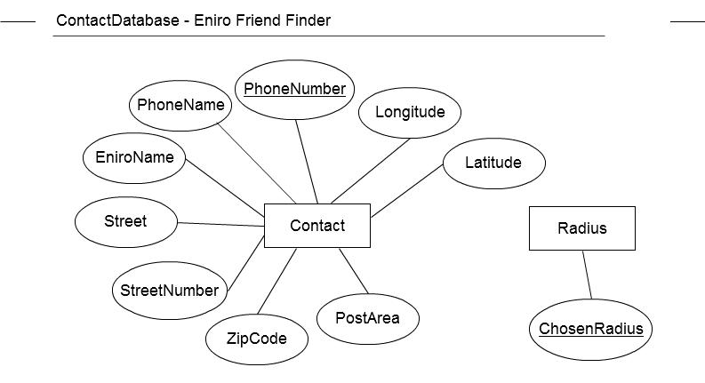

Slide 18
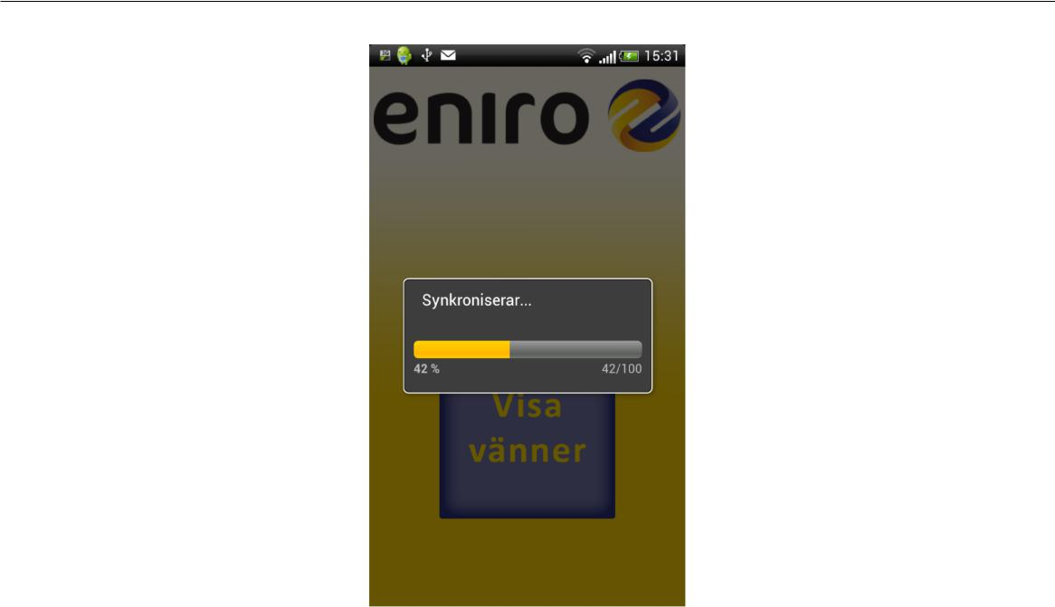
Listing 2: Back-end - Startup screen
public class FriendFinderActivity extends Activity{
public void onCreate(Bundle savedInstanceState){
//Sets the layout.
}
public void onStart(){
//Connects to the database to retrieve data from the ❃
➬ contact table.
}
...
//Methods for synchronizing, checking the internet ❃
➬ connection and connecting to the database.
...
}

Slide 19
Listing 3: Back-end - Synchronization
public class Contact{
public Contact(String phoneNumber, String thePhoneName,
➬ Context context) throws IOException{
//Constructor used to create Contact objects by
➬ searching on Eniro's API and then store the data
➬ in instance variables such as phone book name, ❃
➬ street address, coordinates etc.
}
public Contact(String[] personData, double [] coordinates){
//Constructor used to store data taken from the ❃
➬ database in the Contact object. Thus, when the ❃
22
E//Get methods for the variables such as name, phone ❃
➬ number, address and the distance to the user.
//Methods for retrieving data from the JSON objects that ❃
➬ are returned from Eniro's API.
...
}

Slide 20
public class ContactDatabase extends SQLiteHelper{
public void onCreate(SQLiteDatabase db){
//Creates the tables and views needed in the database.
}
...
//Methods for adding contacts, setting radius and updating ❃
➬ values.
...
}

Slide 21
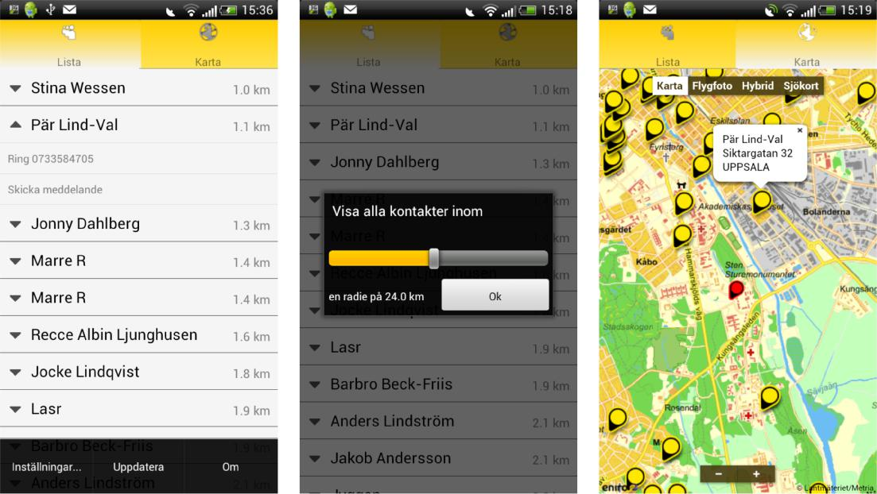

Slide 22
Listing 4: Back-end - User interface after synchronization
public class FFTabWidget extends TabActivity implements >
OnTabChangeListener{
//The class where most of the work is done. A TabHost >
manages the list and map tabs. Since the list view >
and map view are handled and designed in this class >
Çthe back-end perspective of these two have been merged.
public void onCreate(Bundle savedInstanceState){
//Sets the layout.
//Creates the list and map view.

Slide 23
//Creates the JavaScript bridge needed to interact
with the Eniro map API in the .html file.
//Starts searching for the user location.
//Retrieves the Contact list from >
FriendFinderActivity, calculates the distances >
Çwith the Haversine equation and uses Heapsort to
Çsort the list according to the distances to the >
Çuser.
}

Slide 24
public void onStart(){
//Connects to the database to retrieve data from the >
Çradius table.
}
...
//Methods for updating the distances to the user, the set >
Çradius dialog, searching for the user's location, >
Çsetting up the tabs, create and update the list view >
Çand map view, connecting to the database.
...
}

Slide 25

android.location
References
http://www.webology.ir/2007/v4n4/a48.html
http://www.ordnancesurvey.co.uk/oswebsite/business/sectors/wireless/lbs/benefits.html
http://webmsi.free.fr/HEC-MSI-0705T-GR8/nouvellepage2.htm
http://code.google.com/android/toolbox/apis/lbs.html
Location-Based API

Slide 26
THANK YOU

